Slide 1

Web Technology
HTTP
HTML, CSS, JS
Forms
AJAX
Where does Python fit?

Slide 2
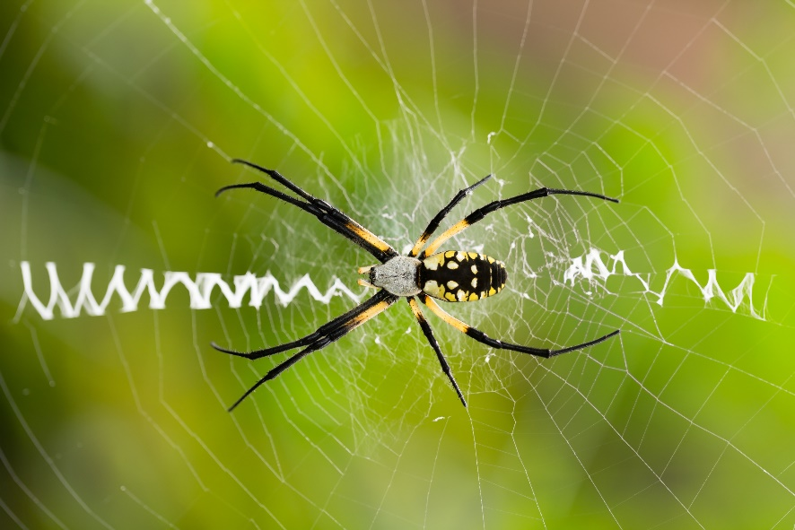
See Also
https://www.youtube.com/watch?v=7_LPdttKXPc
https://en.wikipedia.org/wiki/Hypertext_Transfer_Protocol
http://www.w3schools.com/js/
Notes:
Here is some additional reading about the web … on the web

Slide 3

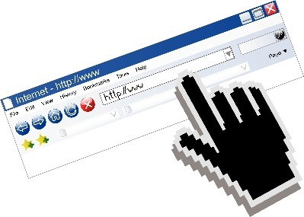
How the Web Works
Web Server
Connect
Send Request
GET /grades/index.html HTTP/1.0
Accept-Language: en-US,en;1=0.8
Cache-Control: max-age=0
(blank line)
Send Response
HTTP/1.0 200 OK
Content-Type: text/html
Content-Length: 24451
<html>
<body>
...
Web Browser
close()
close()
Streams of bytes … two ways (into your program and out of your program)
Disks, consoles, sockets, keyboards, printers
Know how to talk streams and you can talk to anything
Initialization (constructor) is different. Use is the same.

Slide 4

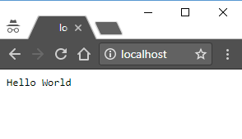
Simple Server
import socket
sock = socket.socket(socket.AF_INET, socket.SOCK_STREAM)
server_address = ('localhost', 80)
sock.bind(server_address)
sock.listen(1)
while True:
try:
print 'waiting for a connection'
connection, client_address = sock.accept()
print 'connection from', client_address
# Read the request from the server
data = connection.recv(1024)
print ":"+data+":"
# Send back a response
connection.sendall("HTTP/1.0 200 OK\n\nHello World")
finally:
connection.close()
Streams of bytes … two ways (into your program and out of your program)
Disks, consoles, sockets, keyboards, printers
Know how to talk streams and you can talk to anything
Initialization (constructor) is different. Use is the same.

Slide 5
Simple Browser
import socket
sock = socket.socket(socket.AF_INET, socket.SOCK_STREAM)
address = ('google.com', 80)
sock.connect(address)
sock.sendall("GET / HTTP/1.0\n\n")
data = sock.recv(1000)
print ":"+data+":"
sock.close()
:HTTP/1.0 200 OK
Date: Sun, 01 Oct 2017 19:20:43 GMT
Expires: -1
Cache-Control: private, max-age=0
Content-Type: text/html; charset=ISO-8859-1
P3P: CP="This is not a P3P policy! See https://www.google.com/support/accounts/answer/151657?hl=en for more info."
Server: gws
X-XSS-Protection: 1; mode=block
X-Frame-Options: SAMEORIGIN
Set-Cookie: NID=113=pGIHc6Atqrth-SaIVnc5oUVw57SScPnM8GyR0fqhKAxpZ7txemB8-B7pscsiH8g4oFQSOCm5YCREusJIQxM0r7BELLP9DGGZ9n-mIOK_Wr6hO9apJ37hT8M-x266E_ne; expires=Mon, 02-Apr-2018 19:20:43 GMT; path=/; domain=.google.com; HttpOnly
Accept-Ranges: none
Vary: Accept-Encoding
Streams of bytes … two ways (into your program and out of your program)
Disks, consoles, sockets, keyboards, printers
Know how to talk streams and you can talk to anything
Initialization (constructor) is different. Use is the same.

Slide 6

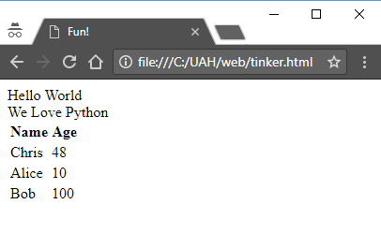
HTML and CSS
<!DOCTYPE html>
<html>
<head>
<title>Fun!</title>
</head>
<body>
<div>Hello World</div>
<div>
<span>We Love </span>
<span>Python</span>
<table>
<tr><th>Name</th><th>Age</th></tr>
<tr><td>Chris</td><td>48</td></tr>
<tr><td>Alice</td><td>10</td></tr>
<tr><td>Bob</td><td>100</td></tr>
</table>
</div>
</body>
</html>
Streams of bytes … two ways (into your program and out of your program)
Disks, consoles, sockets, keyboards, printers
Know how to talk streams and you can talk to anything
Initialization (constructor) is different. Use is the same.

Slide 7

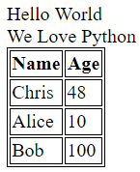
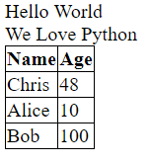
Cascading Style Sheets
<!DOCTYPE html>
<html>
<head>
<title>Fun!</title>
<link rel="stylesheet" href="tinker.css">
</head>
<body>
<div>Hello World</div>
<div>
<span>We Love </span>
<span>Python</span>
<table>
<tr><th>Name</th><th>Age</th></tr>
<tr><td>Chris</td><td>48</td></tr>
<tr><td>Alice</td><td>10</td></tr>
<tr><td>Bob</td><td>100</td></tr>
</table>
</div>
</body>
</html>
table, th, td {
border: 1px solid black;
}
table {
border-collapse: collapse;
}
Streams of bytes … two ways (into your program and out of your program)
Disks, consoles, sockets, keyboards, printers
Know how to talk streams and you can talk to anything
Initialization (constructor) is different. Use is the same.

Slide 8
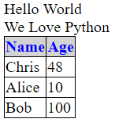
Cascading Style Sheets
<!DOCTYPE html>
<html>
<head>
<title>Fun!</title>
<link rel="stylesheet" href="tinker.css">
</head>
<body>
<div>Hello World</div>
<div>
<span>We Love </span>
<span>Python</span>
<table>
<tr><th>Name</th><th>Age</th></tr>
<tr><td>Chris</td><td>48</td></tr>
<tr><td>Alice</td><td>10</td></tr>
<tr><td>Bob</td><td>100</td></tr>
</table>
</div>
</body>
</html>
th {
color: blue;
background-color: lightgray;
}
table {
border-collapse: collapse;
}
table, th, td {
border: 1px solid black;
}
Streams of bytes … two ways (into your program and out of your program)
Disks, consoles, sockets, keyboards, printers
Know how to talk streams and you can talk to anything
Initialization (constructor) is different. Use is the same.

Slide 9
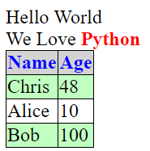
IDs and Classes
<!DOCTYPE html>
<html>
<head>
<title>Fun!</title>
<link rel="stylesheet" href="tinker.css">
</head>
<body>
<div>Hello World</div>
<div>
<span>We Love </span>
<span id="TheWord">Python</span>
<table>
<tr><th>Name</th><th>Age</th></tr>
<tr class="even"><td>Chris</td><td>48</td></tr>
<tr><td>Alice</td><td>10</td></tr>
<tr class="even"><td>Bob</td><td>100</td></tr>
</table>
</div>
</body>
</html>
#TheWord {
color: red;
font-weight: bold;
}
.even {
background-color: #C0FFC0;
}
th {
color: blue;
background-color: lightgray;
}
table {
border-collapse: collapse;
}
table, th, td {
border: 1px solid black;
}
Streams of bytes … two ways (into your program and out of your program)
Disks, consoles, sockets, keyboards, printers
Know how to talk streams and you can talk to anything
Initialization (constructor) is different. Use is the same.

Slide 10

HTML Components
Images and links
Lists (nested)
SVG – Scalable Vector Graphics
Canvas – Pixel drawings
Forms and input elements
Buttons
Text fields
Combo boxes
Check boxes
Streams of bytes … two ways (into your program and out of your program)
Disks, consoles, sockets, keyboards, printers
Know how to talk streams and you can talk to anything
Initialization (constructor) is different. Use is the same.

Slide 11
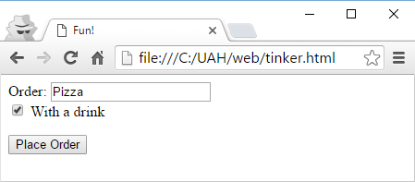
HTML Forms
<!DOCTYPE html>
<html>
<head>
<title>Fun!</title>
</head>
<body>
<form action="nextPage.html" method="get">
Order:
<input type="text" name="dinner" value="Pizza"><br>
<input type="checkbox" name="withDrink" checked>
With a drink
<p>
<input type="submit" value="Place Order">
</form>
</body>
</html>
Streams of bytes … two ways (into your program and out of your program)
Disks, consoles, sockets, keyboards, printers
Know how to talk streams and you can talk to anything
Initialization (constructor) is different. Use is the same.

Slide 12
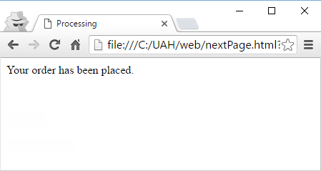
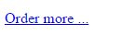
HTML Forms
<!DOCTYPE html>
<html>
<head>
<title>Processing</title>
</head>
<body>
Your order has been placed.
<p>
<a href="tinker.html">Order more ...</a>
<p>
<input type="button" onClick="alert('hi');"
value="Say Hi"/>
<p>
<input type="button"
onClick="location.href='tinker.html';"
value="Order more ..."/>
</body>
</html>
Streams of bytes … two ways (into your program and out of your program)
Disks, consoles, sockets, keyboards, printers
Know how to talk streams and you can talk to anything
Initialization (constructor) is different. Use is the same.

Slide 13
GET vs POST
<!DOCTYPE html>
<html>
<head>
<title>Fun!</title>
</head>
<body>
<form action="nextPage.html" method="get">
Order:
<input type="text" name="dinner" value="Pizza"><br>
<input type="checkbox" name="withDrink" checked>
With a drink
<p>
<input type="submit" value="Place Order">
</form>
</body>
</html>
GET /nextPage.html?dinner=Pizza&withDrink=on HTTP1.0
(blank line)
POST /nextPage.html HTTP1.0
Content-Type: application/x-www-form-urlencoded
(blank line)
dinner=Pizza&withDrink=on
Streams of bytes … two ways (into your program and out of your program)
Disks, consoles, sockets, keyboards, printers
Know how to talk streams and you can talk to anything
Initialization (constructor) is different. Use is the same.

Slide 14
HTTP Verbs
Verb | Request Body | CRUD | RESTful Services
POST | Object data | Create | Create a new resource
GET | None | Read | Read a resource or list of resources
PUT | Object data | Update | Replace an existing resource
PATCH | Patch | Update | Modify part of an existing resource
DELETE | None | Delete | Delete a resource
Streams of bytes … two ways (into your program and out of your program)
Disks, consoles, sockets, keyboards, printers
Know how to talk streams and you can talk to anything
Initialization (constructor) is different. Use is the same.

Slide 15

JavaScript
Java is to JavaScript as Car is to Carpet
Runs in the browser (with limited access)
Now standard in HTML5
Compiled just before running
NodeJS – JavaScript on the server
Can manipulate the DOM to create/change/delete nodes
Can send requests to the server and get back responses
Streams of bytes … two ways (into your program and out of your program)
Disks, consoles, sockets, keyboards, printers
Know how to talk streams and you can talk to anything
Initialization (constructor) is different. Use is the same.

Slide 16

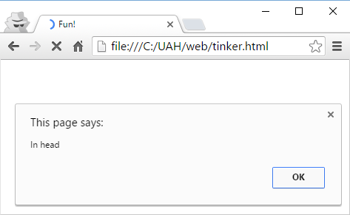
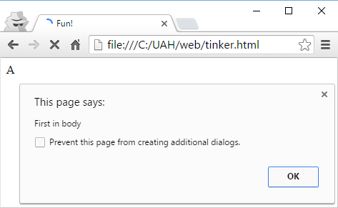
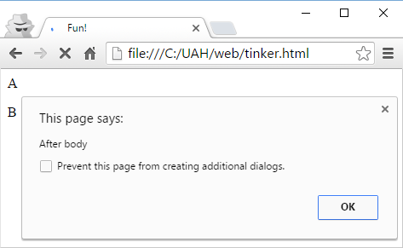
JavaScript
<!DOCTYPE html>
<html>
<head>
<title>Fun!</title>
<script>alert("In head");</script>
</head>
<body>
A<p>
<script>alert("First in body");</script>
B<p>
</body>
<script>alert("After body");</script>
</html>
Streams of bytes … two ways (into your program and out of your program)
Disks, consoles, sockets, keyboards, printers
Know how to talk streams and you can talk to anything
Initialization (constructor) is different. Use is the same.

Slide 17
JavaScript
<!DOCTYPE html>
<html>
<head>
<title>Fun!</title>
</head>
<body>
Hello World
</body>
<script src="tinker.js"></script>
</html>
function everythingReady() {
alert("Page has loaded");
}
function doMath(a,b) {
return a+b;
}
var i = doMath(5,10);
alert("Tinker.js is running "+i);
window.onload = everythingReady;
Streams of bytes … two ways (into your program and out of your program)
Disks, consoles, sockets, keyboards, printers
Know how to talk streams and you can talk to anything
Initialization (constructor) is different. Use is the same.

Slide 18
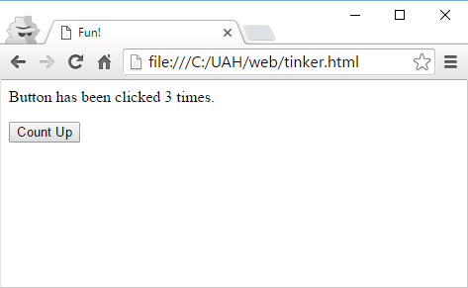
Changing the DOM
<!DOCTYPE html>
<html>
<head>
<title>Fun!</title>
</head>
<body>
Button has been clicked
<span id="ccount">0</span> times.<p>
<input type="button" onClick="countClicks()"
value="Count Up"/>
</body>
<script src="tinker.js"></script>
</html>
var count = 0;
function countClicks() {
count = count + 1;
var span =
document.getElementById("ccount");
span.innerHTML = count;
}
Streams of bytes … two ways (into your program and out of your program)
Disks, consoles, sockets, keyboards, printers
Know how to talk streams and you can talk to anything
Initialization (constructor) is different. Use is the same.

Slide 19
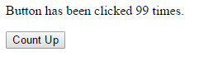
Talking to the Server
<input type="button" onClick="getFromServer()" value="Count Up"/>
var req;
function gotResponse() {
var span = document.getElementById("ccount");
span.innerHTML = req.responseText;
}
function getFromServer() {
req = new XMLHttpRequest();
req.onreadystatechange = gotResponse;
req.open("GET", "http://localhost/getValue");
req.send();
}
Streams of bytes … two ways (into your program and out of your program)
Disks, consoles, sockets, keyboards, printers
Know how to talk streams and you can talk to anything
Initialization (constructor) is different. Use is the same.

Slide 20
Count Server
import socket
sock = socket.socket(socket.AF_INET, socket.SOCK_STREAM)
server_address = ('localhost', 80)
sock.bind(server_address)
sock.listen(1)
while True:
try:
connection, client_address = sock.accept()
data = connection.recv(1024)
connection.sendall("HTTP/1.0 200 OK\n\n99")
finally:
connection.close()

Slide 21
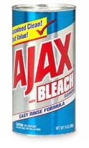
AJAX
AJAX: Asynchronous Javascript And XML
JSON is often used instead of XML
SPA: Single Page Application
The client is a JavaScript application that updates the DOM
No switching between pages with every request
Streams of bytes … two ways (into your program and out of your program)
Disks, consoles, sockets, keyboards, printers
Know how to talk streams and you can talk to anything
Initialization (constructor) is different. Use is the same.

Slide 22

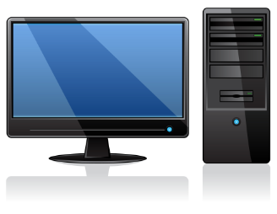

Endpoints
Image files, Javascript files, static HTML, etc.
Database
Tornado, Django
GET /img/arrow.png
/grades
/ext/report
!! Python !!
GET /grades?studID=2431
/admin/users
Streams of bytes … two ways (into your program and out of your program)
Disks, consoles, sockets, keyboards, printers
Know how to talk streams and you can talk to anything
Initialization (constructor) is different. Use is the same.

Slide 23
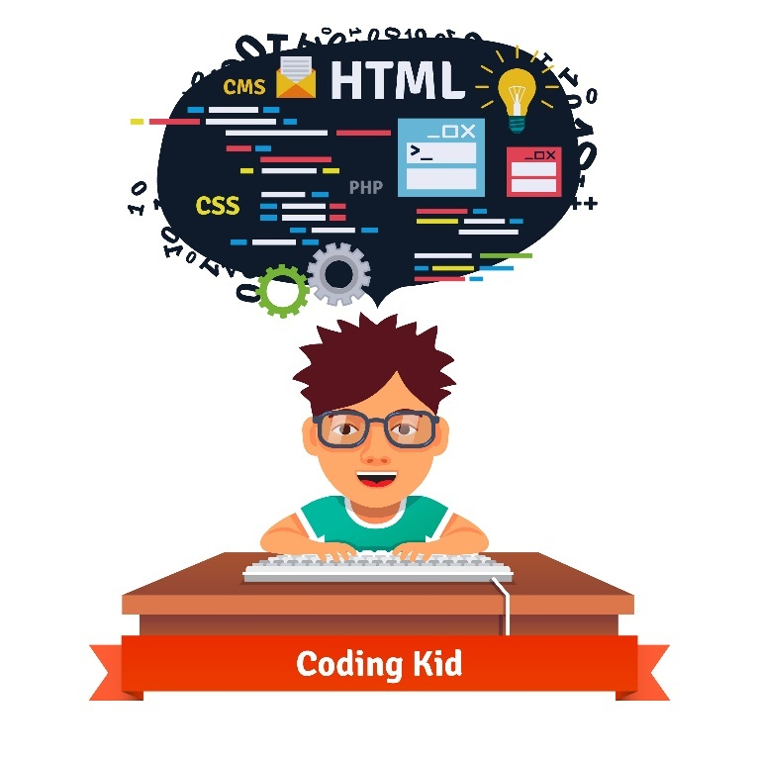
Tinkering
Create “tinker.html” and open it in your browser.
Experiment with our table example.
Experiment with other HTML elements.

